Slide 1
Languages for Dignity: a pedagogy for success at school
Oradea, Romania
26th-27th October 2016
Lecture 2, day 1
Dr Leena Robertson, Dr Brahim Azaoui
http://research.ncl.ac.uk/romtels/resources/

Slide 2
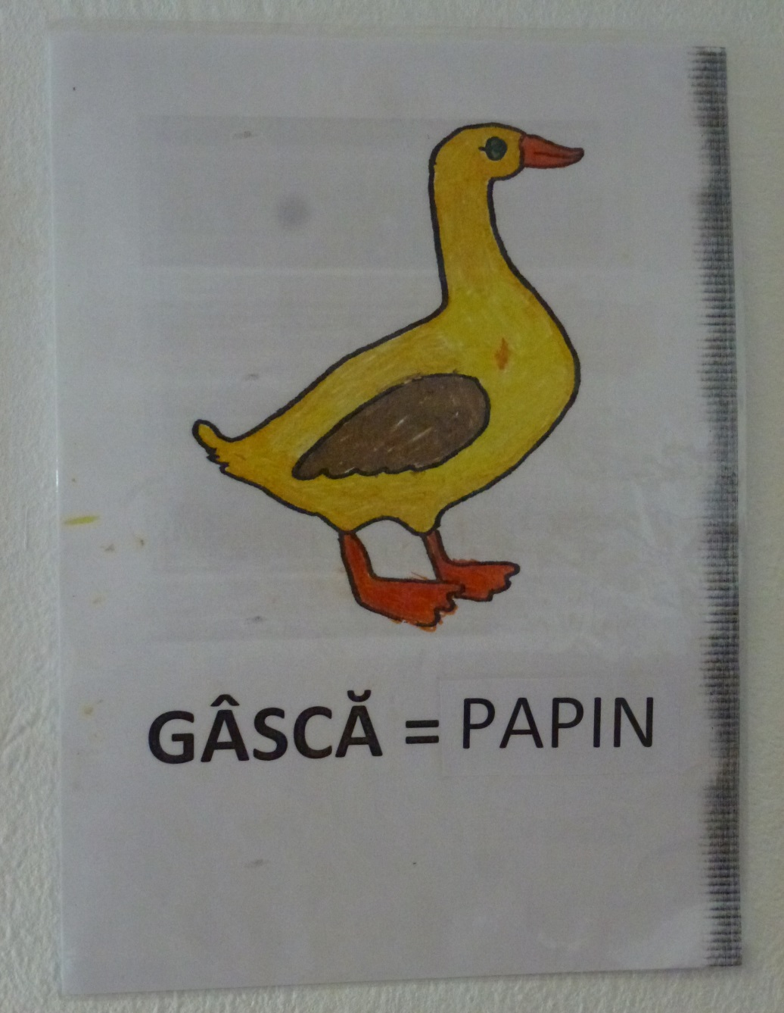
Home language use as a pedagogy for learning in school
Multilingualism, language status, translanguaging
…

Slide 3
Positioning our work
Dell Hymes – sociocultural perspective and language in use, in everyday social contexts
Edward Said – culture and imperialism, ‘Western’ cultures seen as ‘civilized’, ‘others’ as ‘primitive and backward’
Jim Cummins – bilingualism and ‘common underlying proficiency’ and advantages of bilingualism
Tove Skutnabb-Kangas – language rights
Paolo Freire – the development of pedagogies with families/communities
David Gillborn – critical race theory
Ofelia Garcia – translanguaging

Slide 4
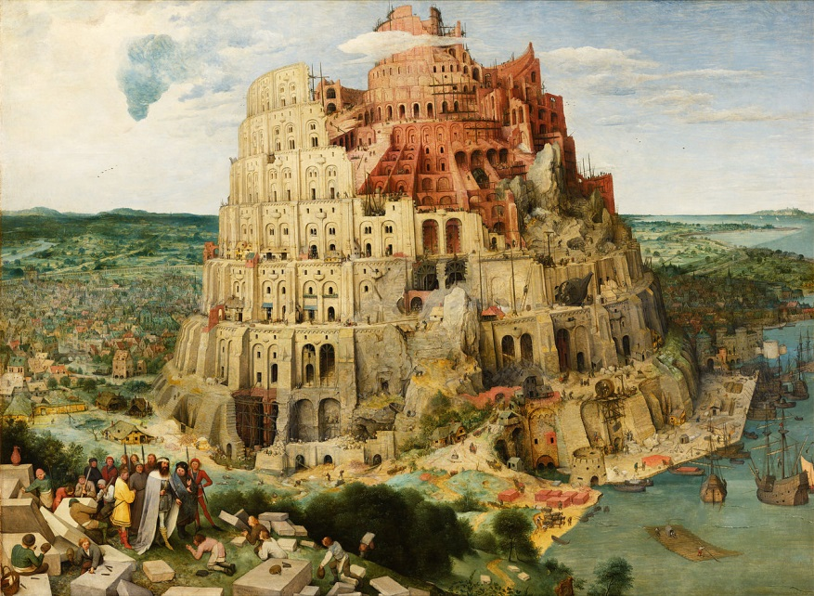
Linguistic policies
Multilingualism = divine curse?
Multilingualism = danger? → need to stratify/rank → one dominant
language
(eg. France, China,
UK …)

Slide 5
Baetens Beardsmore (2003): “fears of bilingualism”
Parental: “What have I done to my child?”
Educational: “Does bilingualism hinder academic progress?”
Cultural: “Will bilingualism lead to cultural alienation?”
Politico-ideological: “Is bilingualism a threat to society and the nation-state?”

Slide 6
Keeping in mind historical contexts
‘Assimilation’ has been a typical approach to diversity in schools in Europe – but we work towards social justice and multilingualism
Segregated classes for ‘new arrivals’ not successful in Britain (1950s-1970s), or in Sweden (1960s), or in Canada (1980s) etc….

Slide 7
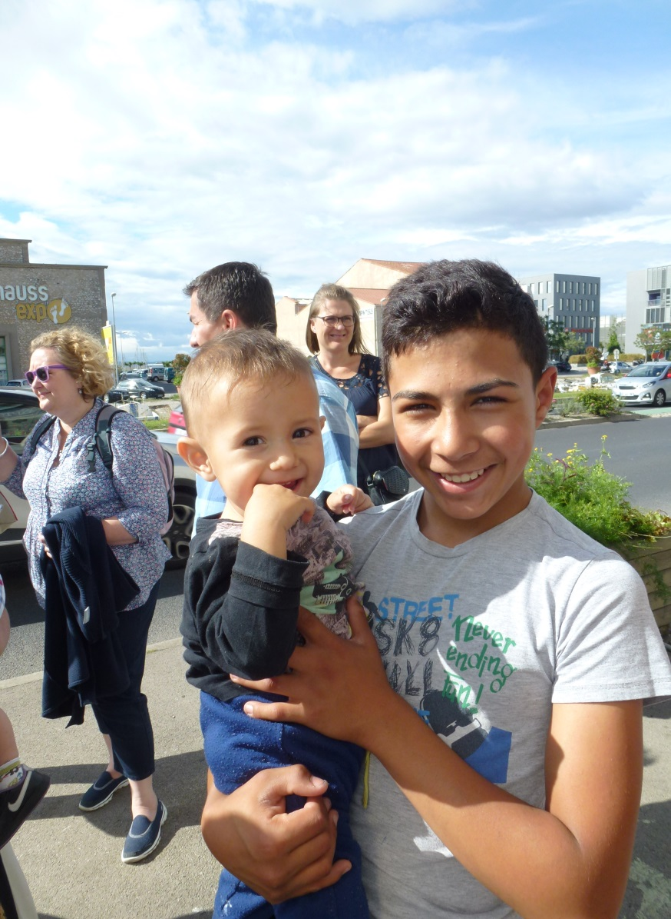
Diversity is not about ‘us’ and ‘them’ – it is about everyone, every day!
Need to see ‘diversity’ as the norm:
not a problem that needs to be fixed
not something exotic that needs to be ‘celebrated’ – occasionally.
And children with ‘diverse’ backgrounds do not need to be fixed either!

Slide 8
But we do want to
FIX THE SYSTEM
that in schools positions multilingual children differently from others, and marginalises them and their ways of learning

Slide 9
Multilingualism
Around 6909 living languages in the world.
http://www.ethnologue.com/
The majority of the world’s population use more
than one language in their daily lives.
In our work we promote multilingualism as a process of
learning in schools and an outcome of education.
Brains do not get confused or full when two languages
are used in school.
Home and school language do not work against each
other – they both support conceptual understanding
We want the cognitive benefits of bilingualism for the children themselves and for the society
The use of home languages in schools speeds up the process of learning the school language

Slide 10
A video example
Let’s compare our languages!

Slide 11
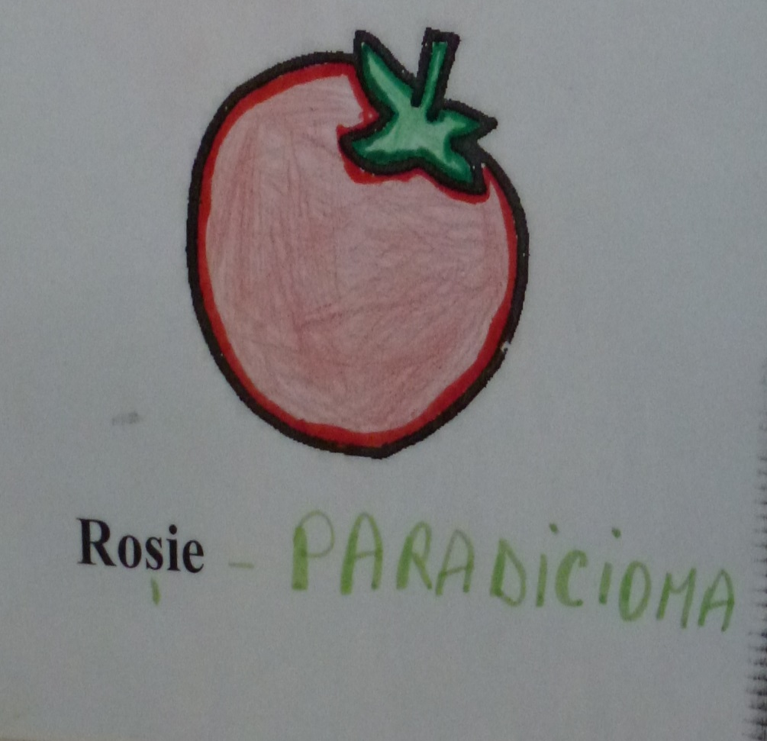
Benefits of multilingualism
(1) conceptual transfer
(2) translation and interpretation
(3) developing metalinguistic skills
(4) building cultural knowledge
(5) building learner identities
(Kenner and Mahera, 2012: 29)

Slide 12
About bilingualism
Common European Framework (2001) :
Plurilingual and pluricultural competence refers to proficiency, of varying degrees, in several languages and experience of several cultures.
“Plurilingual and pluricultural competence does not consist of the simple addition of monolingual competences but permits combinations and alternations of different kinds.

Slide 13
Language status
So, we know from research around the world that multilingualism should be encouraged…
…but…
…most school systems replicate the hierarchy of languages in a society and do not value the languages that children
speak at home.

Slide 14
Formal vs. informal status of languages
Informal status → representation
Negative representation of language = negative representation of its speakers

Slide 15
Reality - multilingualism in the 21st century
At the individual level, language users ask how can they express their cultural values through a language that is traditionally associated with the Other/Others?
At the school level, teachers ask how to protect the identity and integrity of individual languages whilst recognising and promoting the fluidity of diversity and contact?
(Li Wei, 2014)

Slide 16
TRANSLANGUAGING
Is the dynamic process whereby multilingual language users mediate complex social and cognitive activities through strategic employment of multiple semiotic resources to act, to know and to be.
(Garcia and Li Wei, 2014).

Slide 17
Here ‘trans’ means…
…the emphasis on practices that go beyond – they transcend – socially constructed language systems and structures to engage diverse multiple meaning-making systems and subjectivities
…that it has the potential to transform language systems and individual’s cognition and social structures
…that children’s knowledge of the world, relationships with others and their own subjectivities can be transformed.
(Li Wei, 2014)

Slide 18
Translanguaging
the very nature of how a bilingual thinks
and understands and achieves

Slide 19
Home language use as a pedagogy for learning in school
Translanguaging in Newcastle

Slide 20
4 educational advantages of translanguaging
To promote a deeper and fuller understanding of the subject matter;
To support the development of the weaker language;
To facilitate home-school links and co-operation;
To support the integration of more fluent speakers with early learners of the ‘school’ language.
(adapted from Baker, 2001)

Slide 21
Also
Changes power relationships in schools – multilingual children become more knowledgeable of their linguistic and cultural expertise and they can show more expertise than teacher
Synergy in teaching and learning through exchange with peers
Vygotskyan approach – children’s learning is extended with the help of scaffolding from others and the child scaffolds others

